Slide 1

Olist - Brazilian E-Com
Company Performance
& Deliver Insights
Analyzer: Trang Huynh

Slide 2
Table of Contents
01
About Olist Business
02
Data Exploration
03
Business Acumen
04
Conclusions
Get to know Olist business and how it operates.
Describe the dataset
Olist performance and deliver insights for improvement

Slide 3

01
About Olist Business
Get to know Olist business and how it operates.

Slide 4
About Olist
01
About Olist Business
Found in 2014
Olist connects small businesses from all over Brazil to channels with a single contract.
Merchants sell their products through the Olist Store and ship them directly to the customers using Olist logistics partners.
After a customer purchases from Olist Store, a seller gets notified to fulfill that order. Once the customer receives the product, or the estimated delivery date is due, the customer gets a satisfaction survey by email where he can give a note for the purchase experience and write down some comments.

Slide 5

02
Data Exploration
Describe the datasets!

Slide 6

Data Schema
02
Data Exploration

Slide 7
Data Exploration
02
Data Exploration
freight_value is the shipping value from seller to customer. 1 product_id can have different freight_values, maybe depends on the distance.
price is the price of the product. 1 product_id can have different price value, maybe depends on the period of time.
1 product_id can have multiple seller_ids
1 order_id has only 1 purchase_status
Cases that Delivered to Customer Date < Approve Date
Cases that Delivered to Customer Date < Delivered to Carrier
Cases that Delivered to Carrier Date < Purchase Date

Slide 8
Data Exploration
02
Data Exploration
Datetime Min and Max of ‘orders’
Datetime Min and Max of DELIVERED ‘orders’
 | min_date | max_date
order_purchase_timestamp | 2016-09-04 21:15:19 | 2018-10-17 17:30:18
order_approved_at | 2016-09-15 12:16:38 | 2018-09-03 17:40:06
order_delivered_carrier_date | 2016-10-08 10:34:01 | 2018-09-11 19:48:28
order_delivered_customer_date | 2016-10-11 13:46:32 | 2018-10-17 13:22:46
order_estimated_delivery_date | 2016-09-30 0:00:00 | 2018-11-12 0:00:00
 | min_date | max_date
order_purchase_timestamp | 2016-09-15 12:16:38 | 2018-08-29 15:00:37
order_approved_at | 2016-09-15 12:16:38 | 2018-08-29 15:10:26
order_delivered_carrier_date | 2016-10-08 10:34:01 | 2018-09-11 19:48:28
order_delivered_customer_date | 2016-10-11 13:46:32 | 2018-10-17 13:22:46
order_estimated_delivery_date | 2016-10-04 0:00:00 | 2018-10-25 0:00:00

Slide 9

03
Business Acumen
Olist performance and deliver insights for improvement

Slide 10
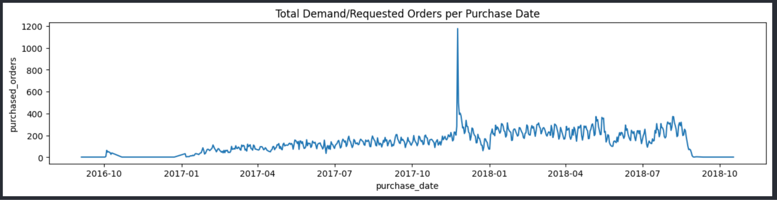
Demand
03
Business Acumen
The demand was quite low at the end of 2016. Then 2017 it started to increase with seasonality until 2018-09. From 2018-09, it decreased and went flat (maybe noise data).
There is a suddenly peak at 2017-11, which didn't happen in 2016-11. Let's take a look at those special days.

Slide 11
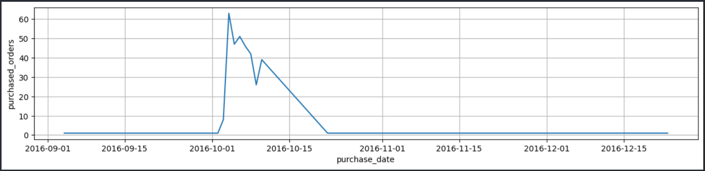
Demand
03
Business Acumen
In 2016, there was very few orders. Olist was founded in 2014, which means it was 2 years but the demand is still very low
=> Question: noise data or actual low orders?

Slide 12
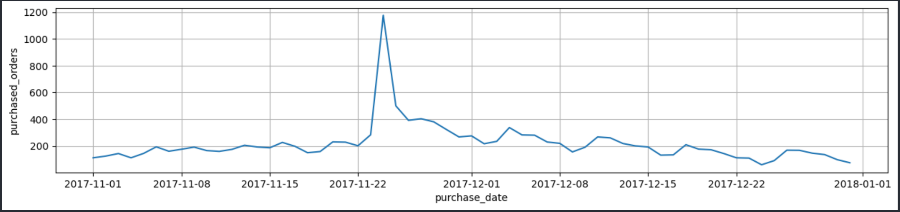
Demand
03
Business Acumen
Google a little bit, we can know that 2017-11-24 is a Black Friday!!!
Before Black Friday 2017, the demand is still very flat.
After a surge increase of Black Friday, the demand decreased from 1200 orders/day to 500 orders/day, and then gradually decreased but still higher than the purchase months of before Black Friday. And after 2017-12-15, the demand comeback to normal.

Slide 13
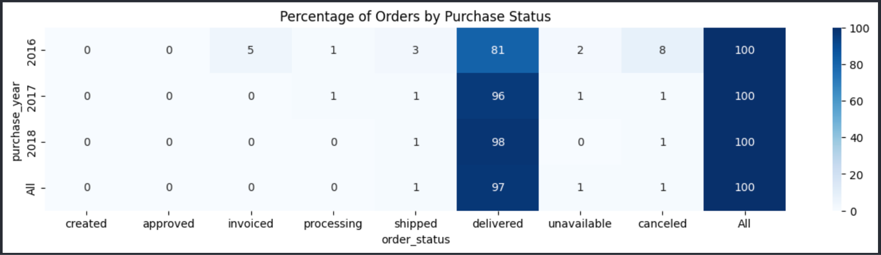
03
Business Acumen
Cancelled Rate:
Cancelled Rate shows the percentage of cancelled orders in our all purchase demands. This metric shows us the percentage of demands that we have goods/freights but cannot successfully fulfill them.
CR average is 1%. CR decreased from 8% in 2016 to 1% in 2017 and 2018 => improvement
Unavailable Rate:
Unavailable Rate shows the percentage of unavailable orders in our all purchase demands. This metric shows us the percentage of demand we cannot manage to have goods/freights from sellers.
UR average is 1%. UR decreased from 2% in 2016 to 1% in 2017 and 0% in 2018 => improvement
Delivered Rate (Fulfillment Rate):
Fulfillment Rate shows the percentage of successful delivered orders in our all purchase demands. This metric shows us the percentage of demand we can fulfill.
FR average is 97%. FR increased from 81% in 2016 to 96% in 2017 and 98% in 2018 => improvement

Slide 14
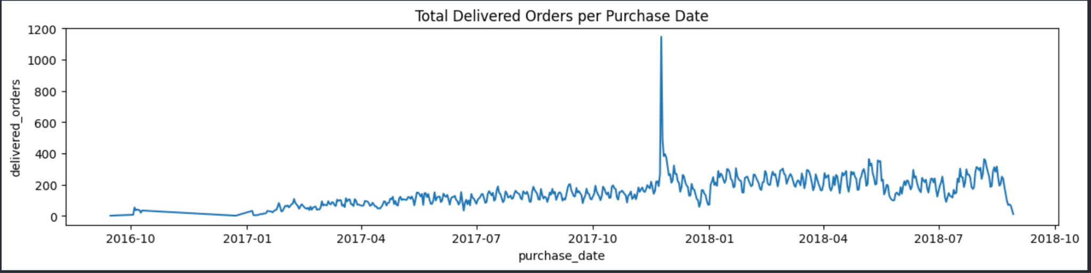
Delivered Orders
03
Business Acumen
order_purchase_timestamp: (2016-09-04, 2018-08-29)
Due to lack of data of 2016 and 2018, to know the growth rate, we can compare the purchase_month:
first-8-month 2017 and first-8-month 2018

Slide 15
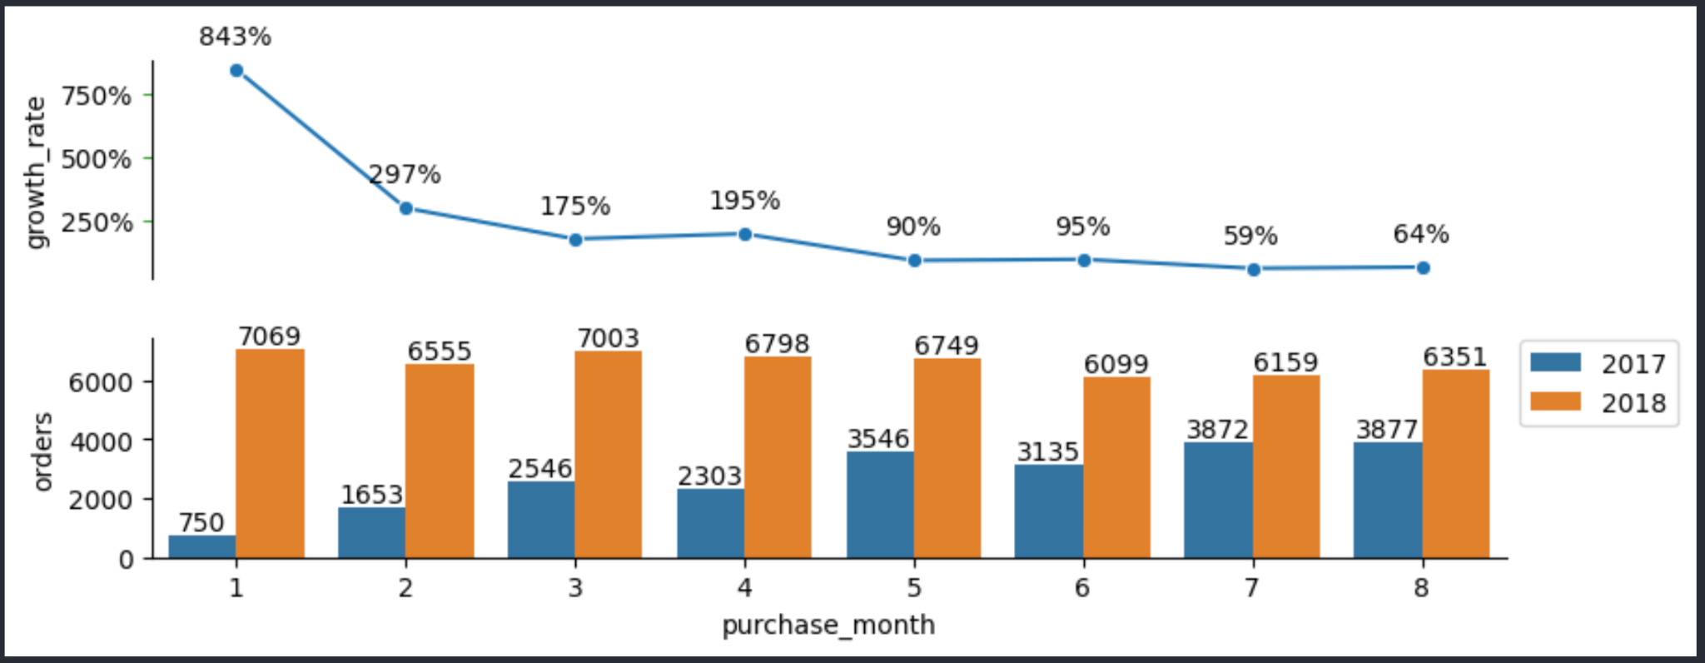
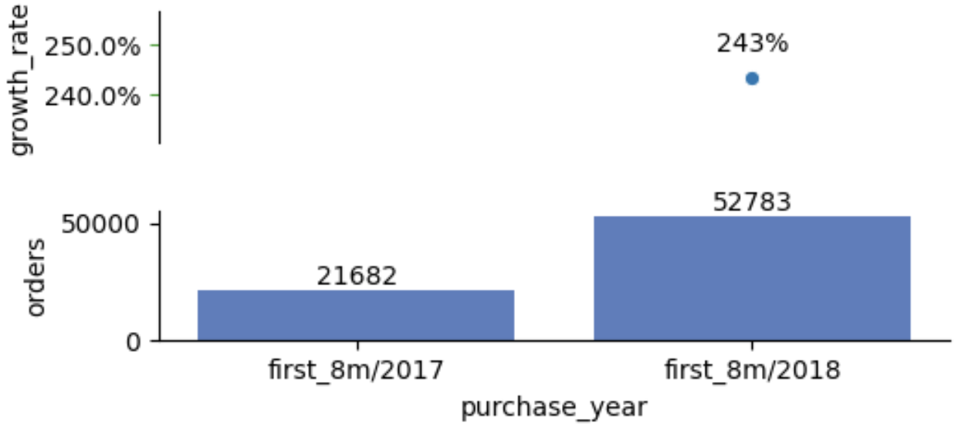
Delivered Orders
03
Business Acumen
Orders in first_8m/2018 keeped fluctuating between 6500 orders/month.
Conclusion:
Olist grew very fast YoY and could get peak at special day like Black Friday.
→ This requires Olist to care more about the delivery performance, the inventory management, especially for special days
From first_8m/2017 to first_8m/2018, there is 243% of growth rate
-> Olist gained such a rapid growth

Slide 16
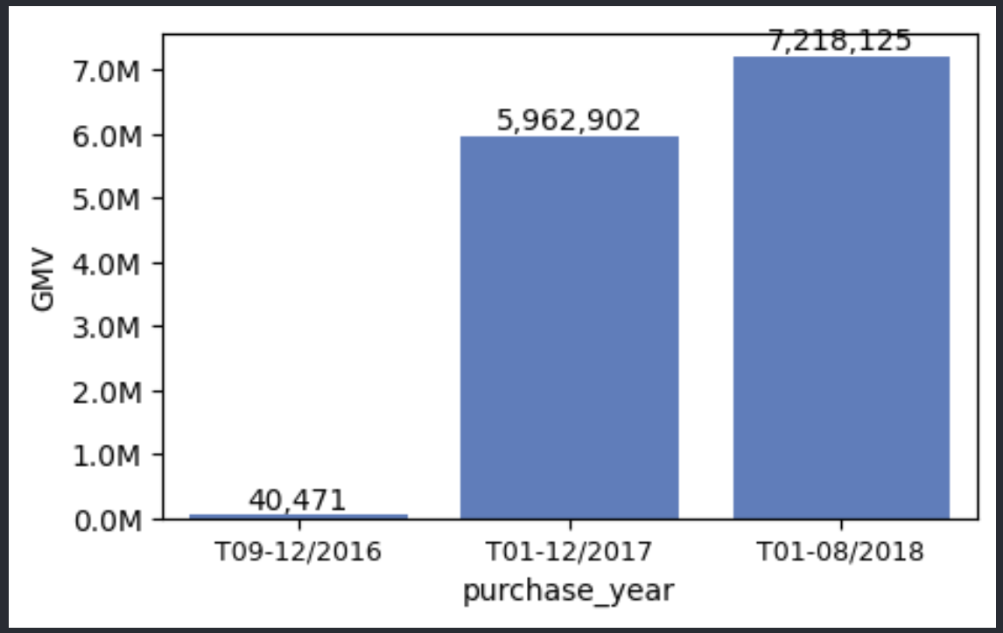
GMV
03
Business Acumen
Gross Merchandise Value (GMV) :
An important figure in e-commerce, it shows the value of merchandise sold (and delivered) less returns and not including shipping costs. The GMV is an indicator of the sale performance of the e-commerce site and is an indicator of the revenue of the site.
- Total GMV of 2017 was 5.96M
- Total GMV of 01/2018 - 08/2018 was 7.22M, although there was just 8 month, but the total GMV was double more than the whole year of 2017.

Slide 17
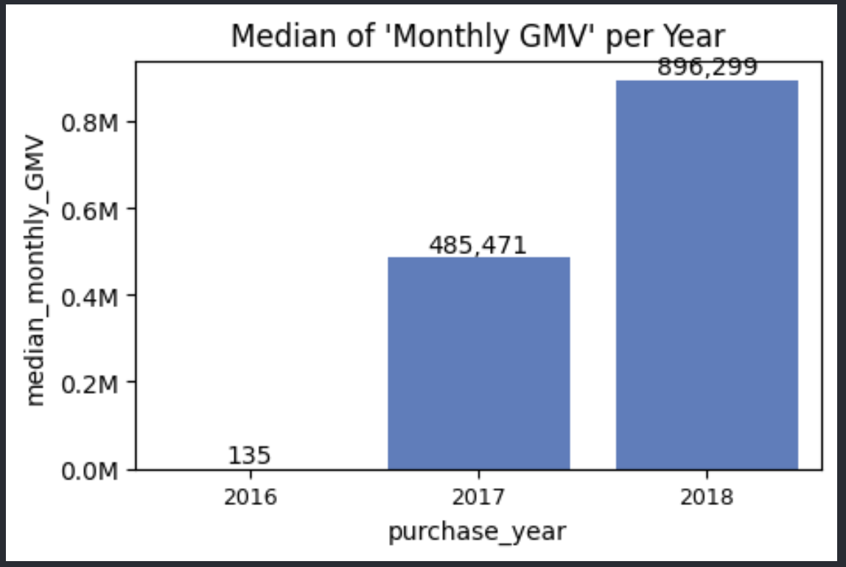
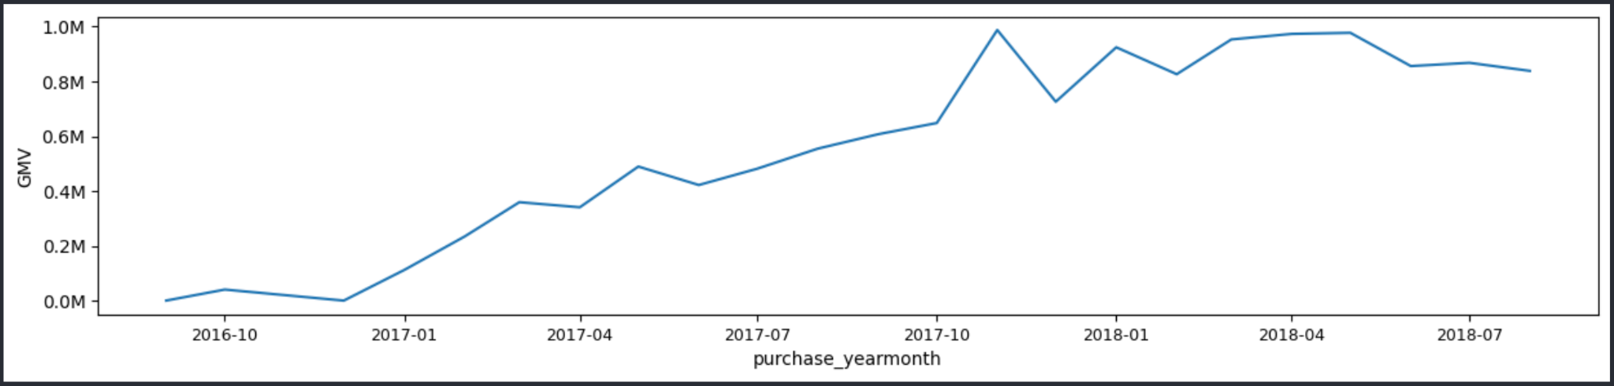
GMV
03
Business Acumen
GMV over months had the trend of increasing.
GMV reached peak at Nov2017, after that there was a drop down in Dec2017, but then after that it still fluctuated between 0.8M GMV.
Conclusion:
GMV of Nov2017 has the peak.
Monthly GMV of 2018 is double more than 2017 (2017: 485K, 2018: 896K)
GMV of Olist overall increased over time

Slide 18
Average Order Per Day & Average Order Value
03
Business Acumen
Average Order Per Day
Average Order Per Day shows the average number of orders per day.
The Average Order Per Day provides understanding about customers behavior and spending patterns so that we can prepare and plan for inventories and delivery.
Average Order Value (AOV)
AOV shows the average order value of customers.
AOV = GMV / total number of orders during the selected date range.
The AOV is not only related to the profit margin but also provides understanding about customers behavior and spending patterns.

Slide 19
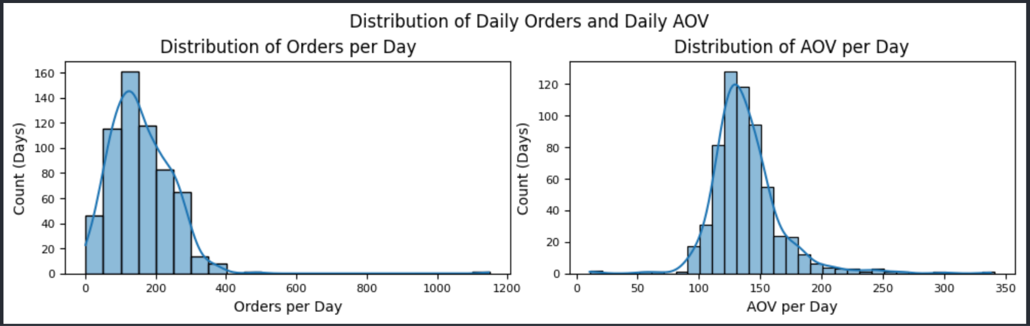
Average Order Per Day & Average Order Value
03
Business Acumen
Conclusion:
In a day, purchased orders could reach to 1200 orders/day -> special date
Mostly, there were about 100-200 orders purchased in a day.
In a day, Average Order Value could reach $337/order/day.
Mostly, there was about $120-150 Average Order Value per order per day.

Slide 20
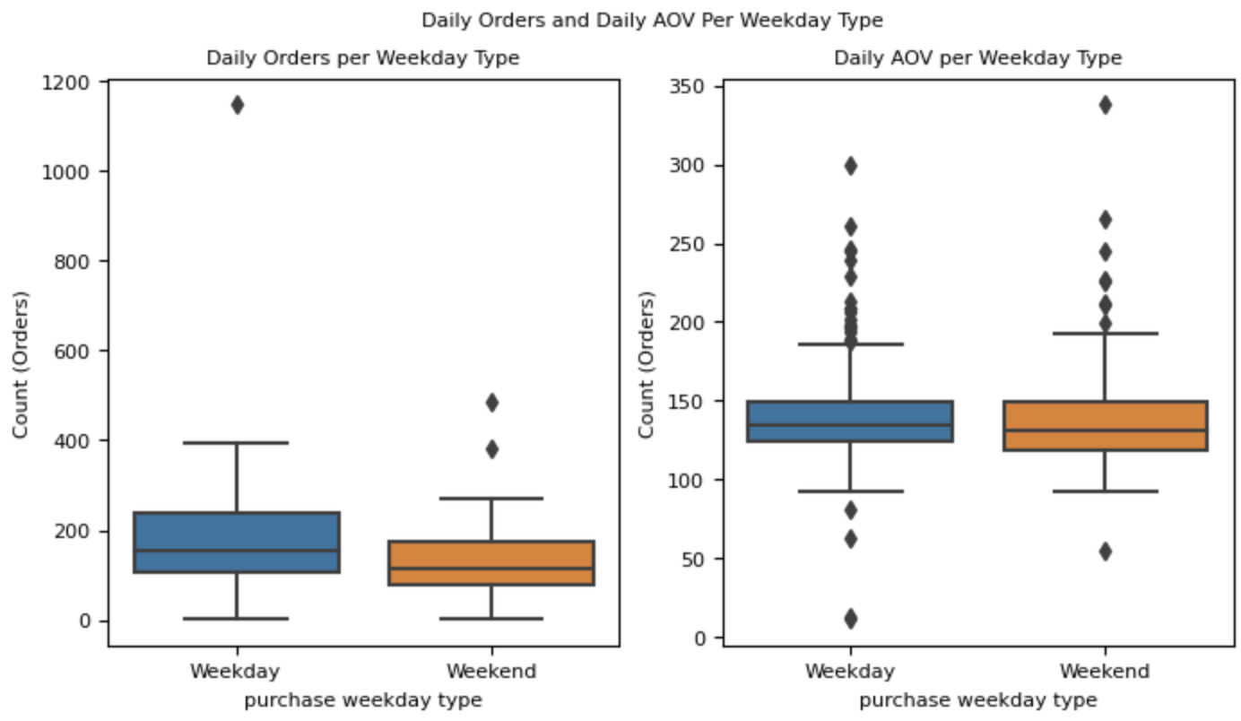
Orders Pattern - Weekday Type
03
Business Acumen
Conclusion:
Customers tend to place orders in Weekday than Weekend
There is not a big difference of Daily AOV between Weekday and Weekend
-> Hypothesis: Purchase at weekend has higher AOV?

Slide 21
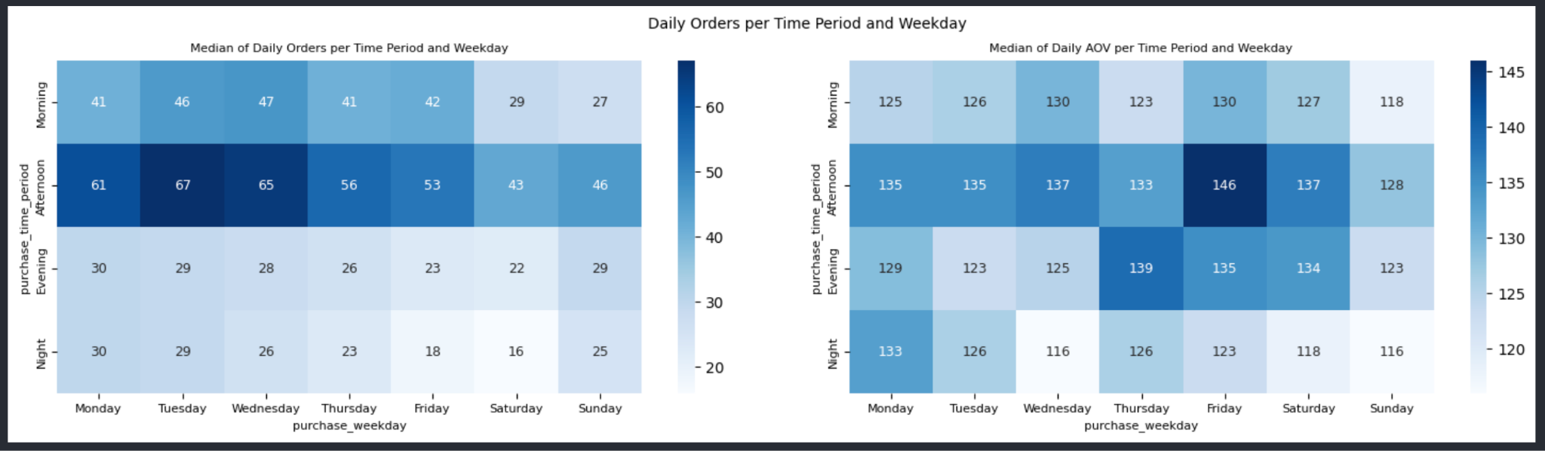
Orders Pattern - Weekday & Hour in a day
03
Business Acumen
- Afternoon of every weekday has the most Daily Orders (12h-17h), especially Monday to Wednesday (>60 Daily Orders)
- Morning of Monday to Friday also has the second most Daily Orders (0h-12h).
- Afternoon of Friday and Evening of Thursday has the highest Daily AOV, which means customers often buy high price products at this period of time
- Afternoon of every weekday has the most Daily AOV, especially Afternoon of Friday.
Recommendations:
Olist can upsell or release new products to increase volume on the Afternoon (12h-17h) from Monday-Friday.
Olist can display high priced products to make customers spend more on Afternoon Friday and Evening Thursday, for example, holding a Premium Brand Day, Golden Hour...

Slide 22
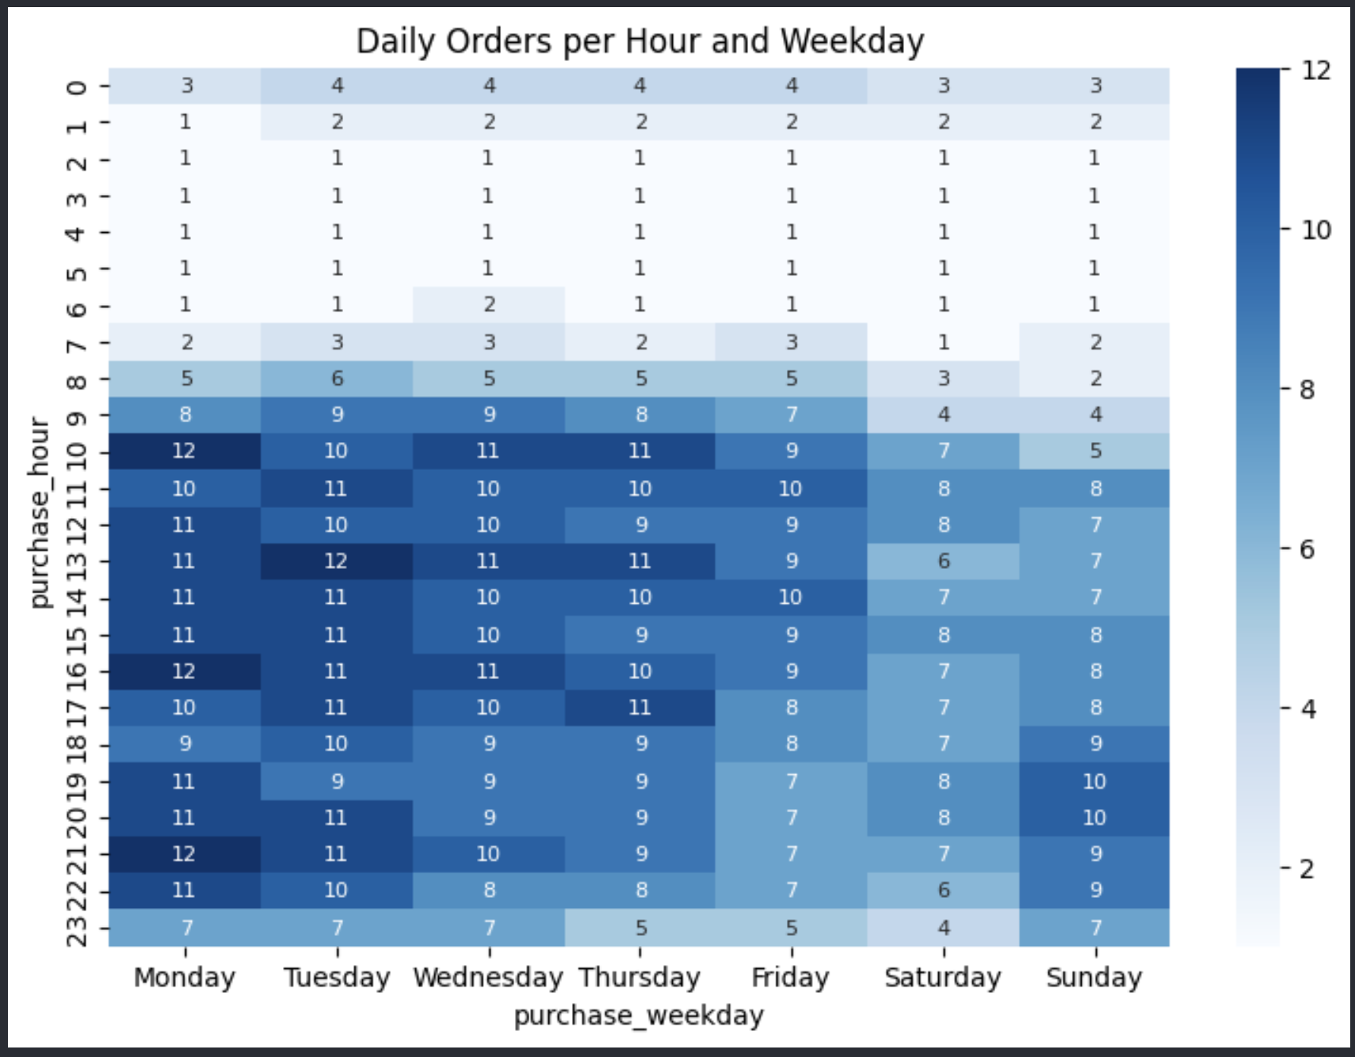
Orders Pattern - Weekday & Hour in a day
03
Business Acumen
The most often blocktime that customers often place orders:
- On Monday, hour at 10, 16, 21 has the highest orders, most often period of time is 10-17h, 19-22h.
- On Tuesday, hour at 13 has the highest orders, most often period of time is 10-18h, 20-22h.
- On Wednesday, hour at 10, 13, 16 has the highest orders, most often period is 11-17h.
- On Thursday, hour at 10, 13, 17 has the highest orders, most often period is 10-11h, 13h-14h, 16h-17h.
- On Friday, hour at 11, 14 has the highest orders, most often period is 10-18h.
- On Saturday, hour at 11, 12, 15, 19, 20 has the highest orders, most often period is 10-21h.
- On Sunday, hour at 19, 20 has the highest orders, most often period is 11-22h.
Recommendations:
These period of hour can be helpful when promoting products for customers by displaying banners, notifications, flash sales, call to action...

Slide 23
Delivery Performance
03
Business Acumen
Delivery Lead Time: From Purchase Date to Deliveried Customer Date
- Show how long does it take for our service to delivery products to customers
- Customers expect this to be very short and can track the delivery progress visibly
Inbound Delivery Days: From Purchase Date to Delivered to Carrier
- Show how long does it take for Sellers to send their products to our Carriers
- Track this metric for improving Seller delivery time further
Outbount Delivery Days: From Delivered to Carrier to Delivered to Customer
- Show how long does it take for Carrier to delivery to customers
- Track this metric for choosing best Carrier and also improving Carrier delivery time further

Slide 24
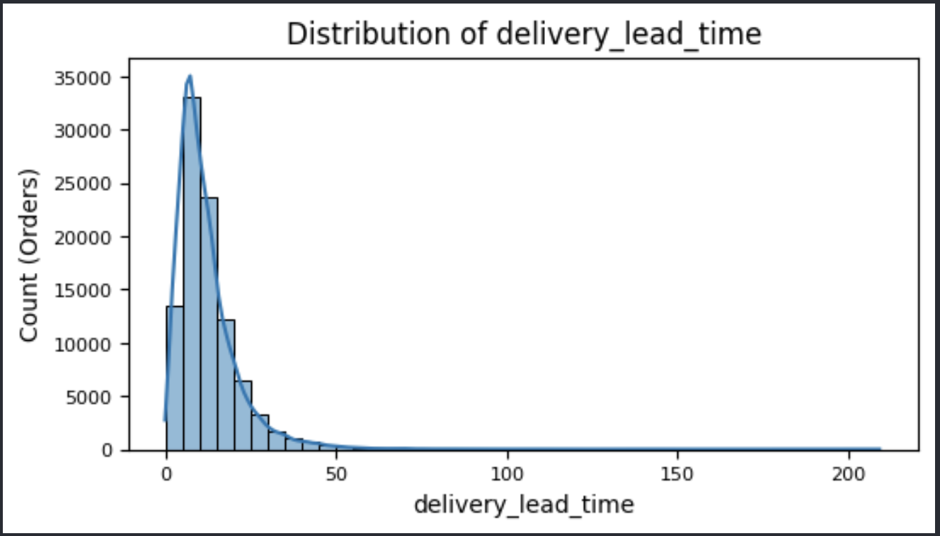
Delivery Performance
03
Business Acumen
Delivery Lead Time:
- Delivery Lead Time can reach 209 days, which is too long
- Most orders were delivered to customers within 10 days after purchased (6-15 days)

Slide 25
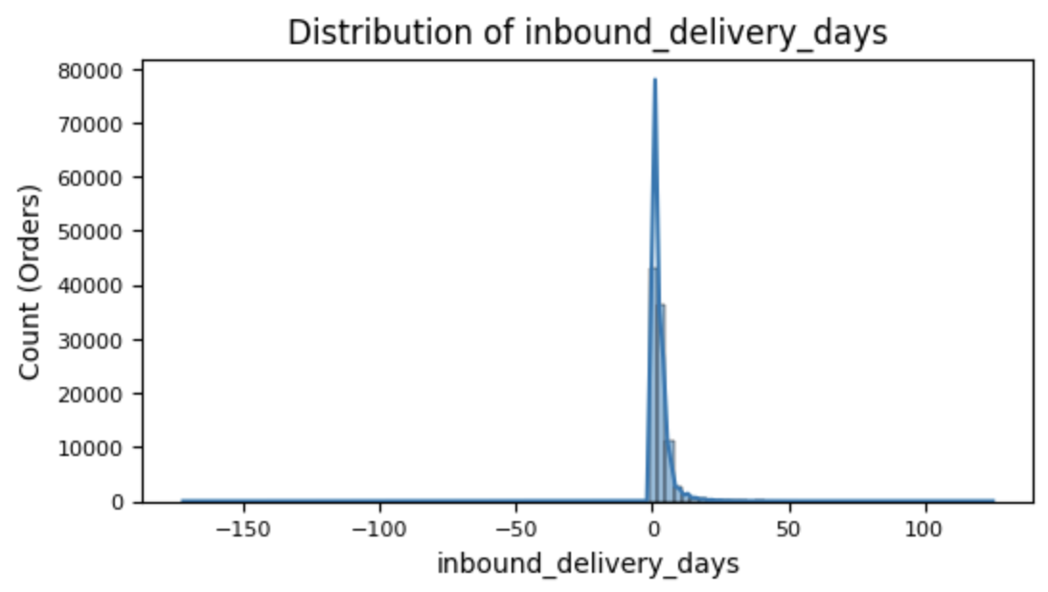
Delivery Performance
03
Business Acumen
Inbound Delivery Days:
- Delivery Inbound Day (Sent to Carrier after purchased) can reach 125 days
- There are also cases that Delivered to Carrier even before the Purchase Date -> need more sense of business model to analyze this further!
- Most orders were delivered to Carrier after purchased within 1-4 days (2 days on average)

Slide 26
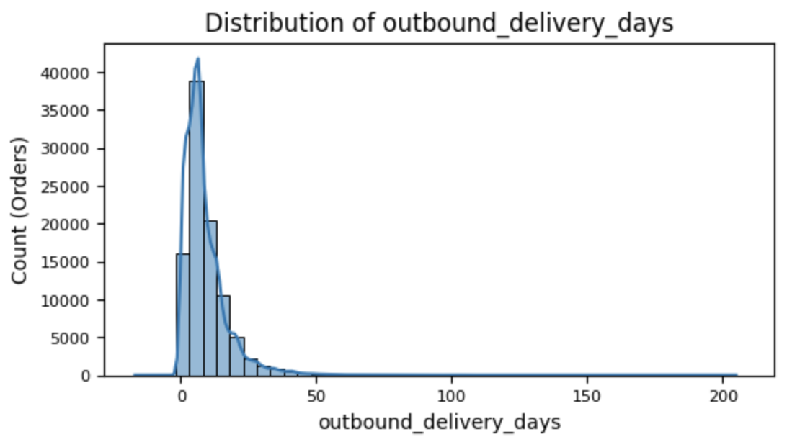
Delivery Performance
03
Business Acumen
Outbound Delivery Days:
- Delivery Outbound Day (Sent to Customers after sending for Carrier) can reach 205 days
- There are also cases that Delivered to Customers even before the Delivered to Carrier Date -> need more sense of business model to analyze this further!
- Most orders were delivered to Customer after sending for Carrier within 4-12 days (7 days on average)

Slide 27
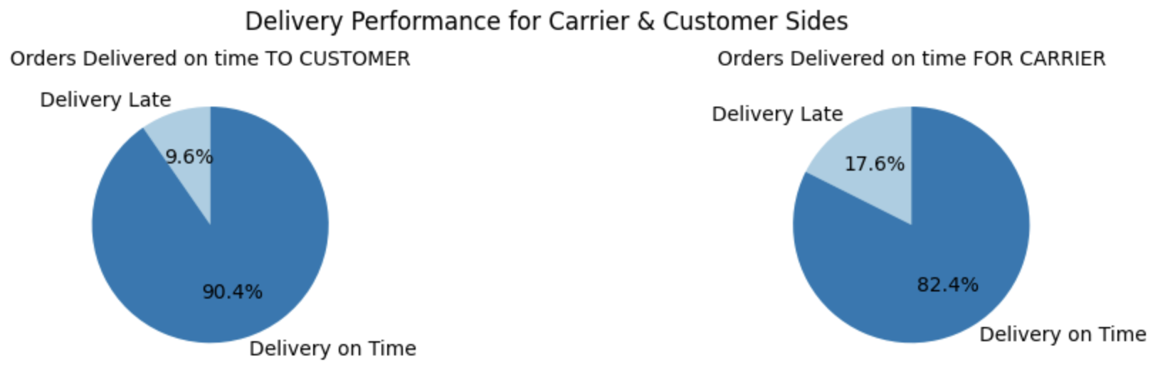
On Time Performance
03
Business Acumen
Delivery To Customer On Time Rate: 90.4%, which is good performance
-> This rate shows how we successfully commit to our customers about estimate and actual delivery date.
Delivery For Carrier On Time Rate: 82.4%
-> This rate shows how sellers successfully commit to send products/items on time for Carrier to ship.

Slide 28
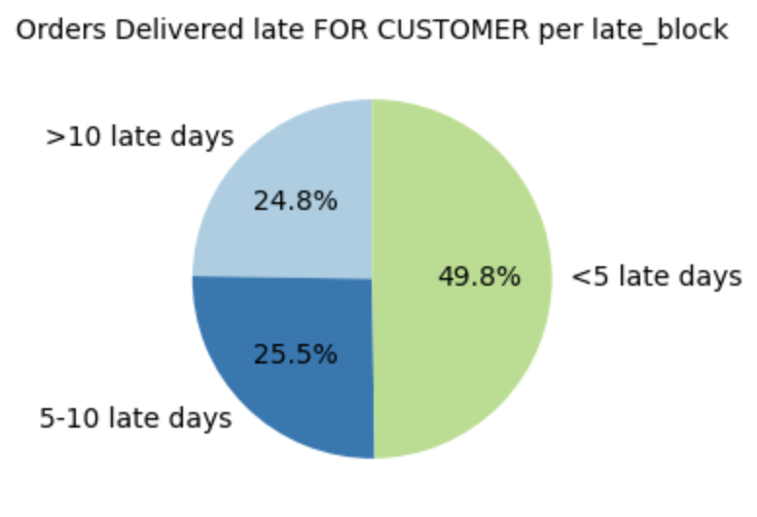
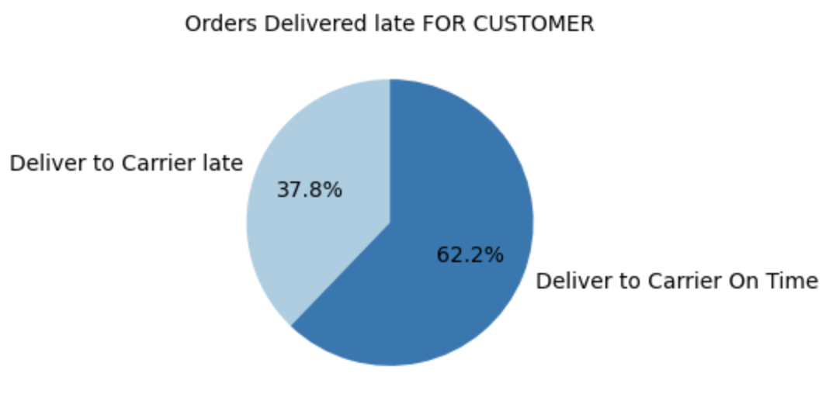
On Time Performance
03
Business Acumen
50% of cases late is <5 late days. 75% late cases are 1-10 late days.
Of all 9.6% Deliver to Customers Late, there were 37.8% due to sellers send products late, and 62.6% due to carrier deliver late.
So how does this late delivery affect customers?

Slide 29
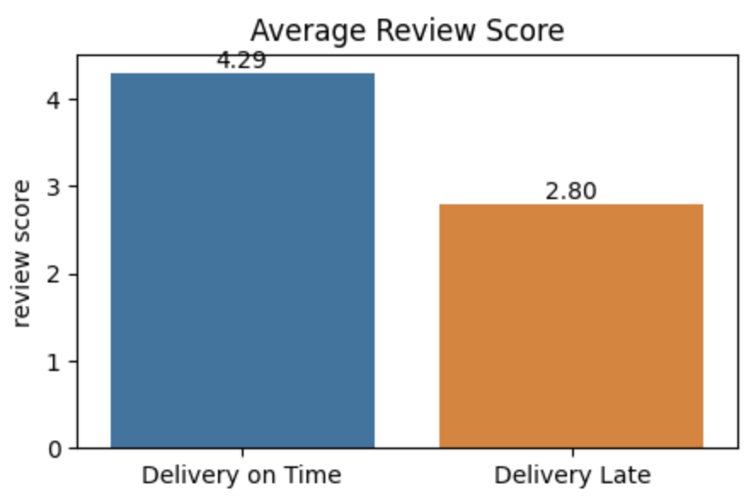
On Time Performance
03
Business Acumen
Delivery On Time Get higher review scores than delivery late (4.29 vs 2.8, what a big difference!)
Conclusion:
- Delivery Lead Days, from after purchased to delivered to customers is 6-15 days (10 days on average).
- Inbound Delivery Lead Days, from after purchased to delivered to carriers, is 1-4 days (2 days on average).
- Outbound Delivery Lead Days, from after delivered to carriers to delivered to customers, is 4-12 days (7 days on average).
- Of all 9.6% Deliver to Customers Late, there were 37.8% due to sellers send products late, and 62.6% due to carrier deliver late.
- Delivery On Time Get higher review scores than delivery late

Slide 30
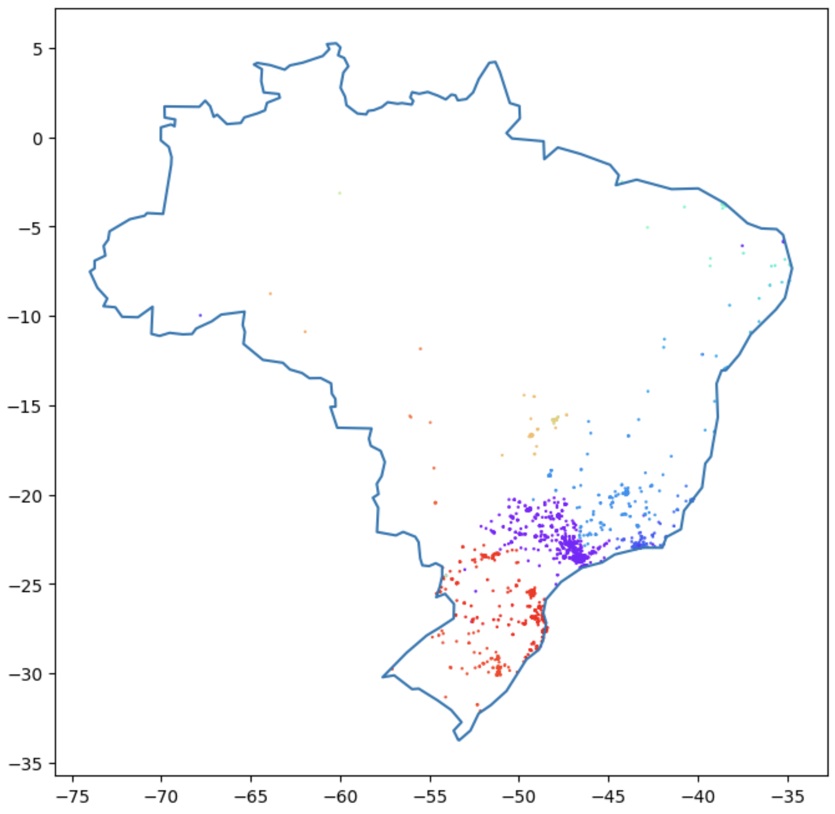
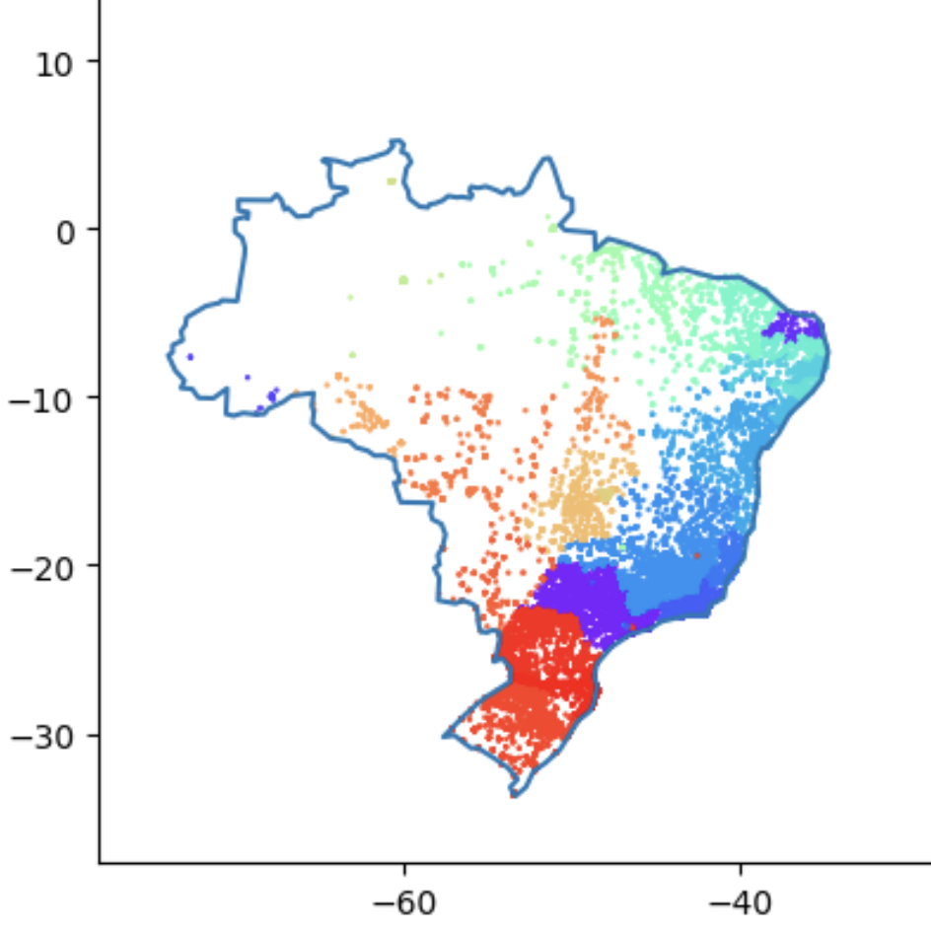
Delivery Performance: Distribution of Customers & Sellers
03
Business Acumen
Customer Distribution:
Seller Distribution:
Olist’s customers are mostly in the eastern of Brazil
Olist’s sellers are mostly in the southeast.
=> Logistic paths are mostly from center to eastern (northeast, east, southeast)

Slide 31
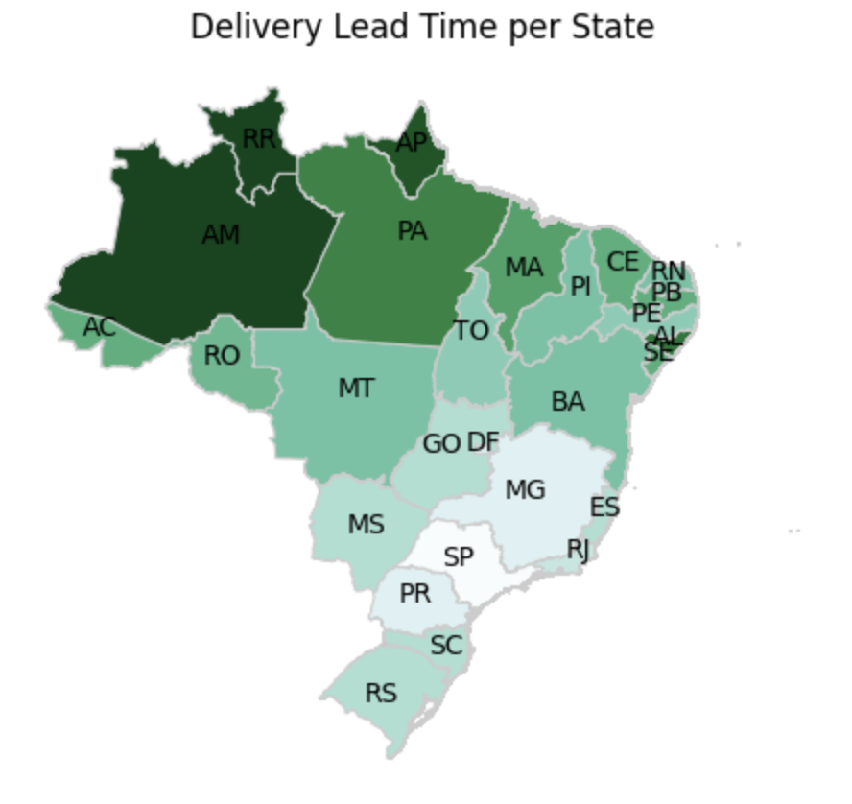
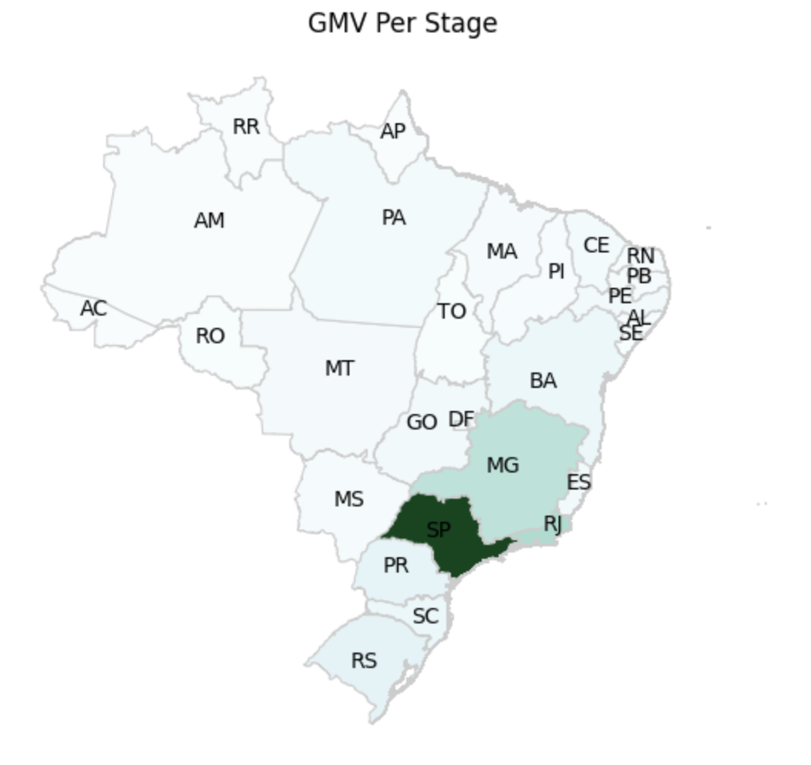
Delivery Performance: Delivery Lead Time & AOV per Location
03
Business Acumen
Average Delivery Lead Time in the northwest is the highest, whereas, southeast is the shortest (sellers concentrates in southeast).
The southeast also has high total GMV
=> Olist’s GMV is concentrated in the southeast
Recommendation:
Focus on keep Delivery Lead Time in the southeast short to sustain our most GMV
Parallelly, find ways to improve Delivery Lead Time of the further states (priority by distance from the southwest)

Slide 32

04
Conclusions & Recommendations

Slide 33
Conclusions
04
Conclusions & Recommendations
Business Performance
Olist has gain rapid growth rate from 2017 to 2018 (growth rate of 243% first 8 months).
Total GMV of 2017 was 5.96M. Total GMV of 01/2018 - 08/2018 was 7.22M, although there was just 8 month.
Olist Monthly GMV of 2018 is double more than 2017 (2017: 485K, 2018: 896K)
Mostly, Olist has about 100-200 orders in a day. And has $120-150 Average Order Value per day.
Customers of Olist tend to place orders in Weekday than Weekend, and mostly in the Afternoon (12h-17h).

Slide 34
Conclusions
04
Conclusions & Recommendations
Delivery Performance
Olist has delivery performance very well due to suitable Delivery Lead Time and low rate of Late Delivery:
Delivery Lead Time: 10 days after purchased (6-15 days)
Inbound Delivery Lead Time: within 1-4 days (2 days on average)
Outbound Delivery Lead Time: within 4-12 days (7 days on average)
Delivery To Customer On Time Rate: 90.4%
Delivery For Carrier On Time Rate: 82.4%
Of all 9.6% Deliver to Customers Late, there were 37.8% due to sellers send products late, and 62.6% due to carrier deliver late.
Delivery On Time Get higher review scores than delivery late
Olist’s customers are mostly in the eastern of Brazil, whereas sellers are mostly in the southeast.
Average Delivery Lead Time in the northwest is the highest, whereas, southeast is the shortest (sellers concentrates in southeast). Olist’s GMV is concentrated in the southeast too.

Slide 35
Recommendations
04
Conclusions & Recommendations
Olist can upsell or release new products to increase volume on the Afternoon (12h-17h) from Monday-Friday.
Olist can display high priced products to make customers spend more on Afternoon Friday and Evening Thursday, for example, holding a Premium Brand Day, Golden Hour...
These period of hour in slide 22 can be helpful when promoting products for customers by displaying banners, notifications, flash sales, call to action…
Focus on keep Delivery Lead Time in the southeast short to sustain our most GMV. Parallelly, find ways to improve Delivery Lead Time of the further states (priority by distance from the southwest) (maybe build a hub for reducing cost).
Additional data/dataset should collect:
Distance data: to analyze better for the routes, as well as how to improve Delivery Lead Time
Discount & promotion related data: to analyze ways to improve GMV
User demographic data: to find way to understand customers better -> serve customers better -> increase GMV

Slide 36
Thanks!
Do you have any questions?
Contact:
httrang146@gmail.com

